Slide 1
An Introduction to Qualitative Research
Flick, U. (2014). An introduction to qualitative research. Sage.
Presented by: Barira Bakhtawar
Notes:
Flick, U. (2014). An introduction to qualitative research. Sage.

Slide 2
Toulmin (1990) four tendencies for empirical social research in philosophy and science as a way forward:
the return to the oral
the return to the particular
the return to the local
the return to the timely.

Slide 3
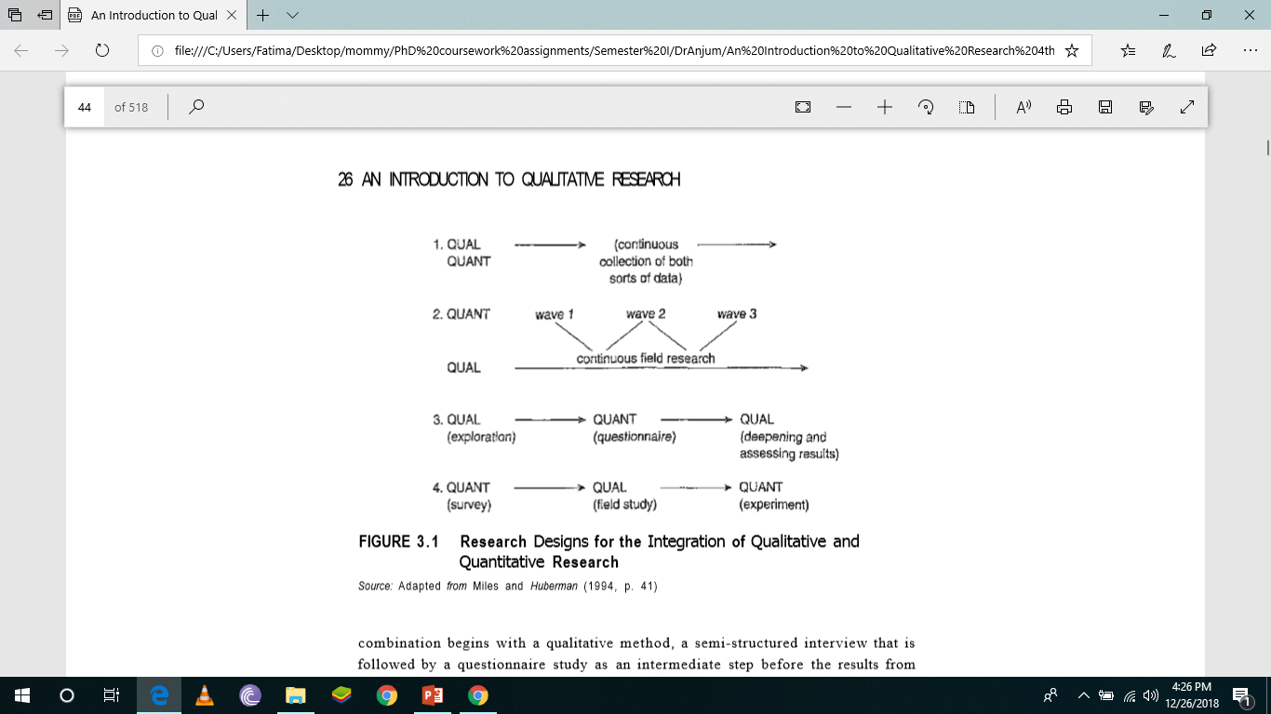
Integration of Qualitative and Quantitative Research
Miles and Huberman (1994, p. 41) outline four types of designs for integrating both approaches in one design

Slide 4
In the first design, both strategies are pursued in parallel.
Continuous observation of the field provides a basis on which, in a survey, the several waves are related or from which these waves are derived and shaped in the second design.
The third combination begins with a qualitative method, a semi-structured interview that is followed by a questionnaire study as an intermediate step before the results from both steps are deepened and assessed in a second qualitative phase.
In the fourth design, a complementary field study adds more depth to the results of a survey in the first step and is followed by an experimental intervention in the field for testing the results of the first two steps.

Slide 5
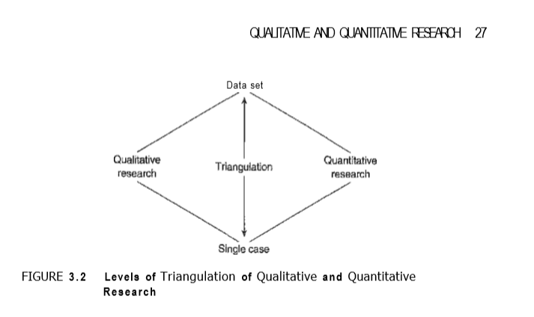
Triangulation of Qualitative and Quantitative Research

Slide 6
Linking Qualitative and Quantitative Results
More often combinations of both approaches are established by linking the results of qualitative and quantitative research in the same project or different projects, one after the other or at the same time. This combination can be pursued with different aims:
• to obtain knowledge about the issue of the study which is broader than the single approach provided; or
• to mutually validate the findings of both approaches.

Slide 7
Basically, three sorts of outcomes of this combination (see Kelle and Erzberger 2004) may result:
1. qualitative and quantitative results converge, mutually confirm, and support the same conclusions;
2. both results focus different aspects of an issue (e.g., subjective meanings of a specific illness and its social distribution in the population), but are complementary to each other and lead to a fuller picture;
3. qualitative and quantitative results are divergent or contradictory.

Slide 8
Code of Ethics
Murphy and Dingwall speak of "ethical theory" in this context, which they see linked to four issues:
Non-maleficence - researchers should avoid harming participants. Beneficence - research on human subjects should produce some positive and identifiable benefit rather than simply be carried out for its own sake. Autonomy or self-determination - research participants' values and decisions should be respected. Justice - all people should be treated equally. (2001, p. 339)

Slide 9
Several forms of literature in a qualitative study
• theoretical literature about the topic of your study;
• empirical literature about earlier research in the field of your study or similar fields;
• methodological literature about how to do your research and how to use the methods you chose;
• theoretical and empirical literature to contextualize, compare, and generalize your findings.

Slide 10
Strauss and Corbin (1998, pp. 49-52) list several ways of using the literature:
1 Concepts from the literature can be a source for making comparisons in data you have collected.
2 To be familiar with the relevant literature can enhance sensitivity to subtle nuances in data.
3 Published descriptive materials can give accurate descriptions of reality helpful for understanding your own material.
4 Existing philosophical and theoretical knowledge can inspire you and give you an orientation in the field and material

Slide 11
. 5 The literature can be a secondary source of data—for example, quotations from interviews in articles may complement your own materials.
6 The literature can be used beforehand to formulate questions that help you as a springboard in early interviews and observations.
7 The literature may stimulate questions while you analyze your material.
8 Areas for theoretical sampling can be suggested by the literature.
9 The literature can be used for confirming findings or can be overcome by your findings.

Slide 12
Hart gives a concise definition about a literature reviews contents:
The selection of available documents (both published and unpublished) on the topic, which contain information, ideas, data, and evidence written from a particular standpoint to fulfill certain aims or express certain views on the nature of the topic and how it is to be investigated, and the effective evaluation of these documents in relation to the research being proposed. (1998, p. 13)

Slide 13
Research Perspectives in the Field of Qualitative Research
1. Subjective Meaning: Symbolic Interactionism
Blumer summarizes the starting points of symbolic interactionism as "three simple premises":
The first premise is that human beings act toward things on the basis of the meanings that the things have for them ... . The second premise is that the meaning of such things is derived from, or arises out of, the social interaction that one has with one's fellows. The third premise is that these meanings are handled in, and modified through, an interpretative process used by the person in dealing with the things he encounters. (1969, p. 2)

Slide 14
Research Perspectives in the Field of Qualitative Research
2. The Making of Social Realities: Ethnomethodology
Harold Garfinkel is the founder of this school.
Ethnomethodological studies analyze everyday activities as members' methods for making those same activities visibly-rational-and reportable-for-all-practical-purposes, i.e. "accountable," as /organizations of commonplace everyday activities. The reflexivity of that phenomenon is a singular feature of practical actions, of practical circumstances, of common sense knowledge of social structures, and of practical sociological reasoning. (1967, p. vii)

Slide 15
Research Perspectives in the Field of Qualitative Research
3. Cultural Framing of Social and Subjective Reality: Structuralist Models
Here a distinction is made between the surface of experience and activity, on the one hand, and the deep structures of activities, on the other. While the surface is accessible to the participant subject, the deep structures are not accessible to everyday individual reflections.

Slide 16
Research Perspectives in the Field of Qualitative Research
Recent Developments in Psychology: Social Representations
This approach is increasingly used as a theoretical framework for qualitative studies that deal with the social construction of such phenomena as health and illness, madness, or technological change in everyday life.

Slide 17
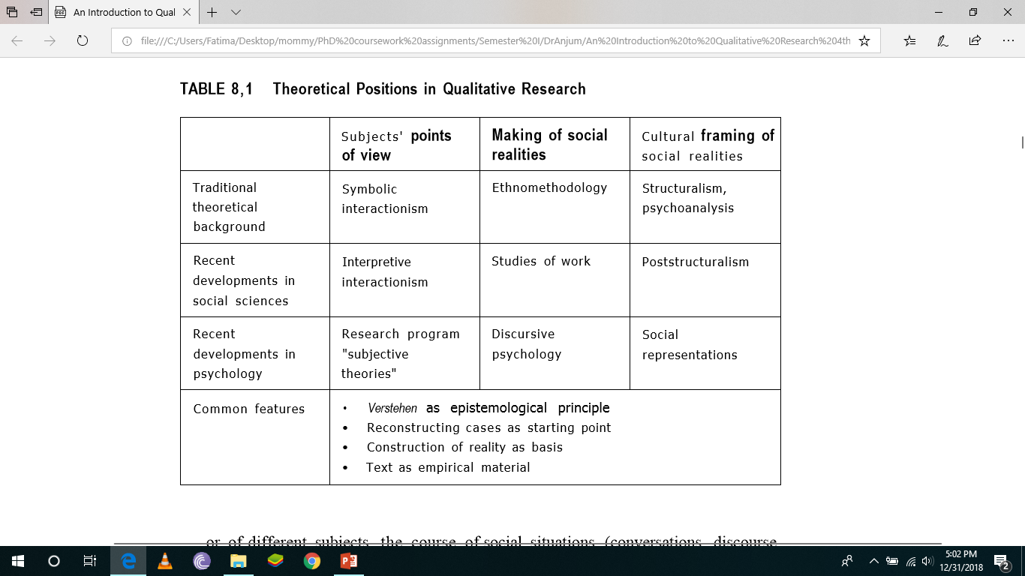

Slide 18
Feminism and Gender Studies: Feminist researchers have contributed to reflection on qualitative methods by developing a research program for studying issues of gender, gender relations, inequality, and neglect of diversity.
Positivism and Constructionism: Bryman (2004,p.ll) summarizes several assumptions of positivism: (1) only phenomena and knowledge confirmed by the sense can be warranted as knowledge (phenomenalism); (2) theories are used to generate hypotheses that can be tested and allow explanations of laws to be assessed (deductivism); (3) knowledge can be produced by collecting facts that provide the basis for laws (inductivism); (4) science must and can be conducted in a way that is value free and thus objective; and (5) there is a clear distinction between scientific and normative statements.

Slide 19
A contrasting position is that of social constructionism (or constructivism) (see also Flick 2004b). A number of programs with different starting points are subsumed under these labels. What is common to all constructionist approaches is that they examine the relationship to reality by dealing with constructive processes in approaching it.

Slide 20
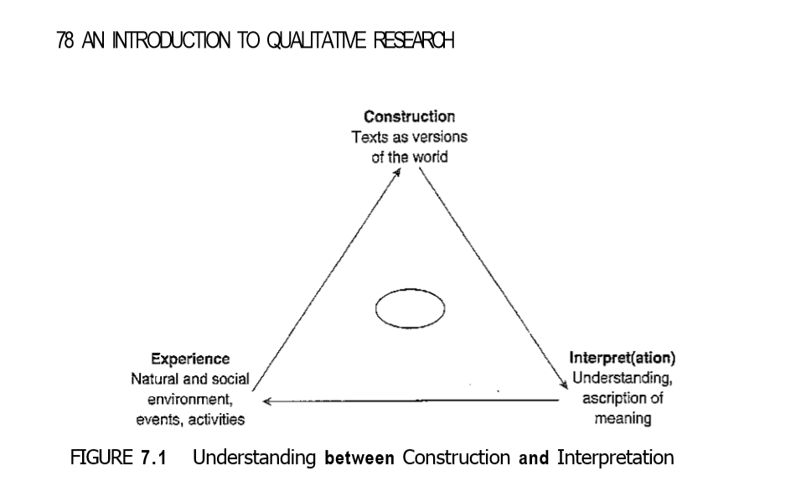

Slide 21
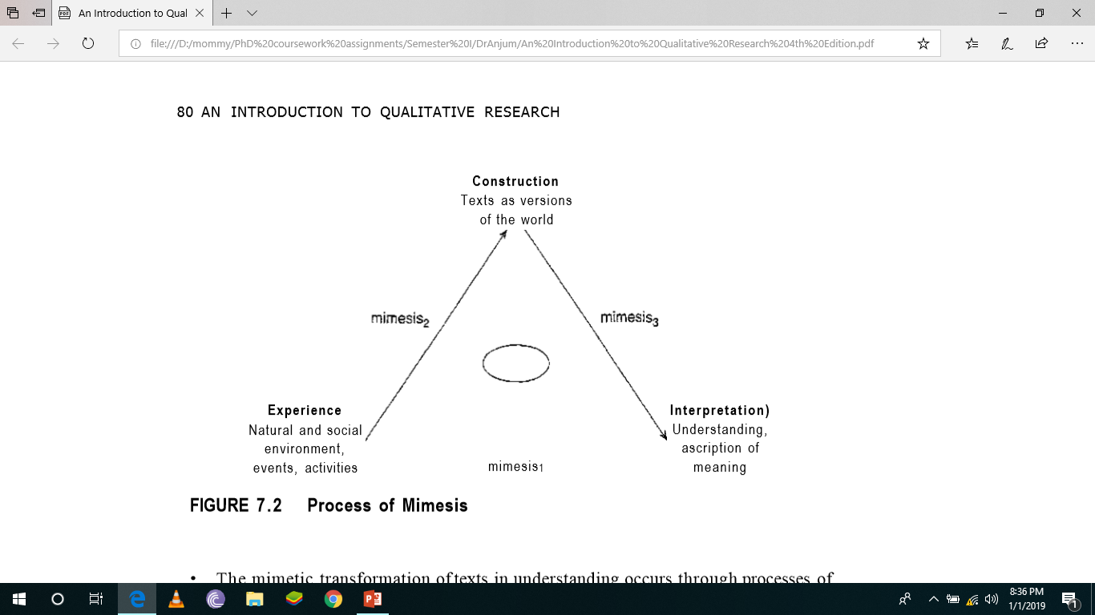
Mimesis refers to the transformation of (originally, for example, in Aristotle, natural) worlds into symbolic worlds.

Slide 22
"The principle of openness implies, that the theoretical structuring of the issue under study is postponed until the structuring of the issue under study by the persons being studied has 'emerged'" (Hoffinann-Riem 1980, p. 343).

Slide 23
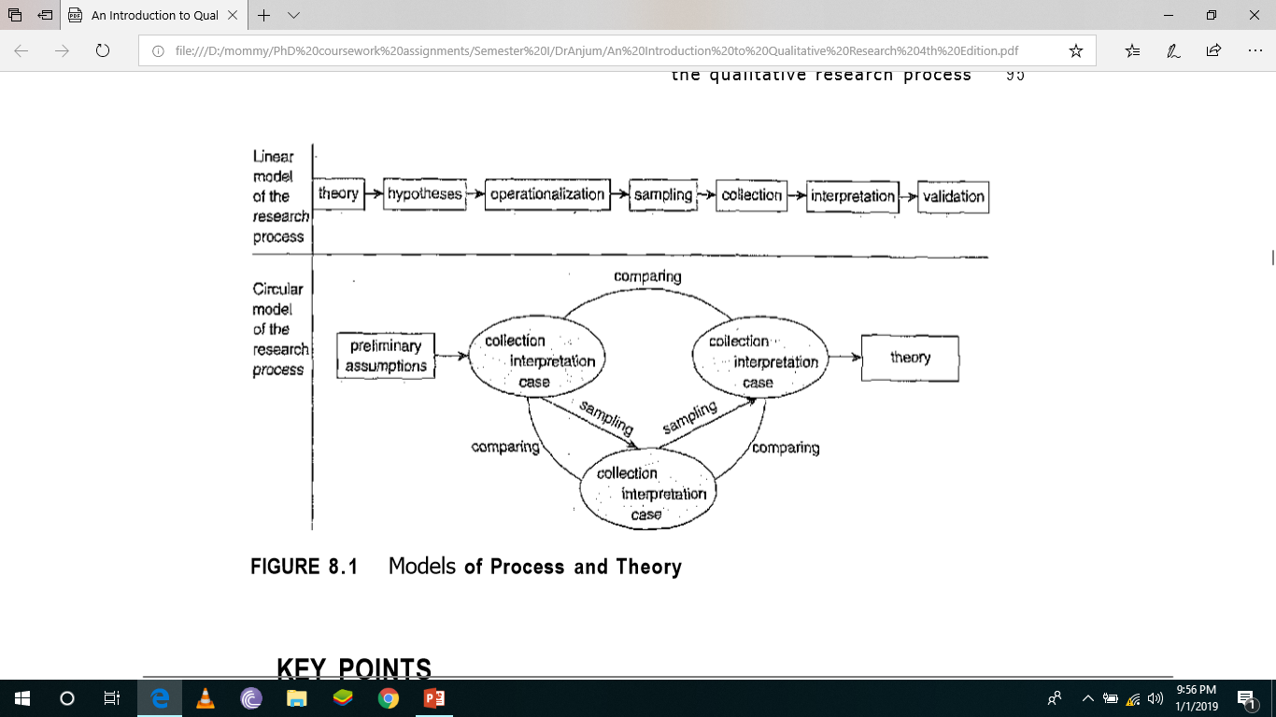

Slide 24
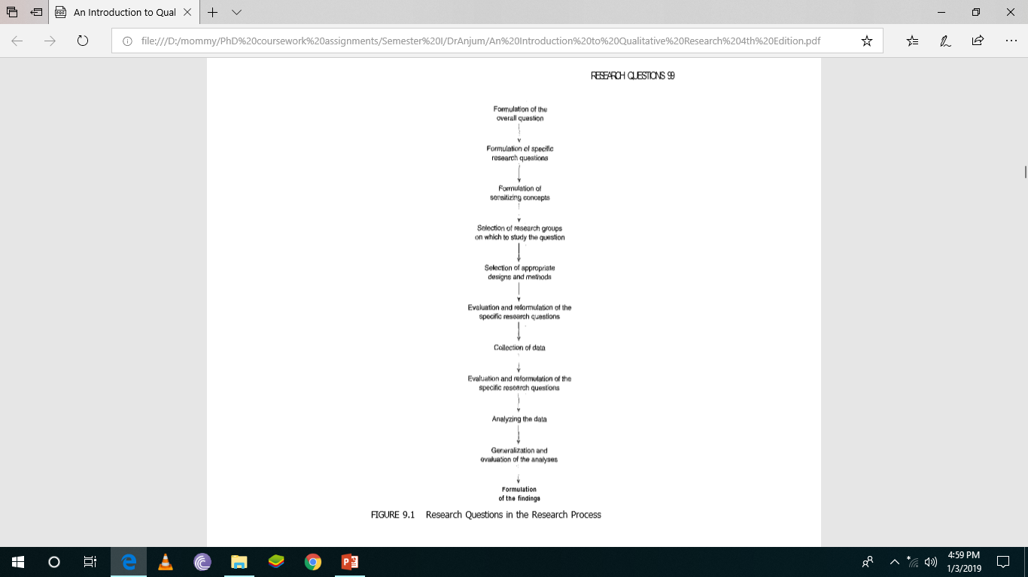
Research Questions

Slide 25
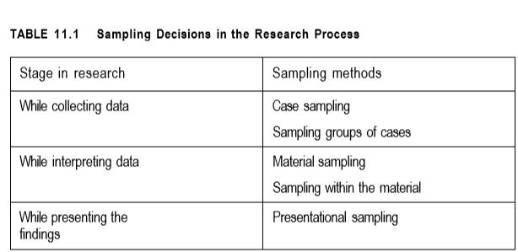
Sampling Decisions in the Research Process

Slide 26
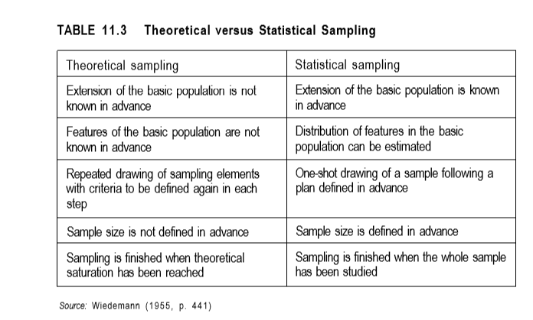

Slide 27
Sampling Strategies in Qualitative Research
• A priori determination
• Complete collection
• Theoretical sampling
• Extreme case sampling
• Typical case sampling
• Maximal variation sampling
• Intensity sampling
• Critical case sampling
• Sensitive case sampling
• Convenience sampling
• Primary selection
• Secondary selection

Slide 28
If you construct a concrete research design for your study, you should consider the following components
• the goals of the study;
• the theoretical framework;
• its concrete questions;
• the selection of empirical material;
• the methodological procedures;
• the degree of standardization and control;
• the generalization goals; and
• the temporal, personal, and material resources available.

Slide 29
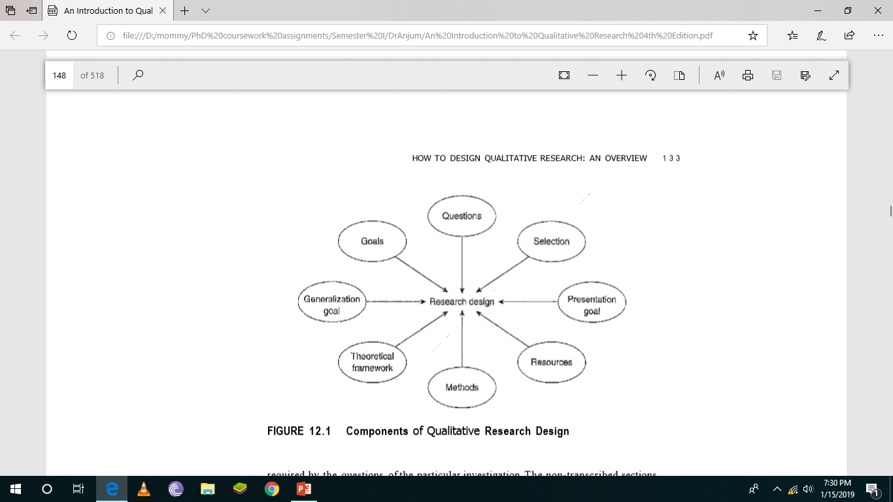

Slide 30
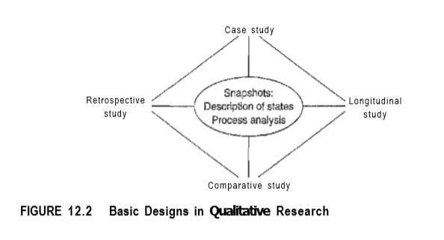

Slide 31
Types of Interviews
The Focused Interview
The Semi-Standardized Interview
The Problem-Centered Interview
The Expert Interview
The Ethnographic Interview
Narrative- Interview

Slide 32
The Structure Laying Technique
In a second meeting with the interviewee, no more than one or two weeks after the first interview, the structure laying technique (SLT) is applied.

Slide 33
Focus Groups
A focus group interview is an interview with a small group of people on a specific topic. Groups are typically six to eight people who participate in the interview for one-half to two hours.
A small number of individuals, brought together as a discussion or resource group, is more valuable many times over than any representative sample. Such a group, discussing collectively their sphere of life and probing into it as they meet one another's disagreements, will do more to lift the veils covering the sphere of life than any other device that I know of.

Slide 34
What Is the Role of the Moderator?
Formal direction: to control of the agenda of the speakers and to fixing the beginning, course, and end of the discussion.
Topical steering: introduction of new questions and steering the discussion towards a deepening and extension of specific topics and parts
Steering the dynamics: interaction ranges from reflating the discussion to using provocative questions, polarizing a slow discussion, or accommodating relations of dominance by purposively addressing those members remaining rather reserved in the discussion.

Slide 35
What Is the Process, and What Are the Elements of Group Discussions?
• At the beginning, an explanation of the (formal) procedure is given.
• A short introduction of the members to one another and a phase of warming up follow to prepare the discussion.
• The actual discussion starts with a "discussion stimulus," which may consist of a provocative thesis, a short film, a lecture on a text, or the unfolding of a concrete problem for which a solution is to be found.
• In groups with members that did not know each other in advance, phases of strangeness with, of orientation to, adaptation to, and familiarity with the group as well as conformity and the discussion drying up are gone through.

Slide 36
Four types of participant roles:
• the complete participant;
• the participant-as-observer;
• the observer-as-participant;
the complete observer.

Slide 37
Steps in Conducting a Visual, Photographs and Film Analysis
1 "Looking and feeling“
2 What research question are you asking?
3 Structured microanalysis is conducted of individual scenes and sequences, which should lead to detailed descriptions and patterns
4 When answering the research question, search for patterns in the entire film. Searching for patterns extends to the whole film/photograph in order to answer the research question
Visual data methods provide new ways of documenting the visual side of social settings and practices and of making these a part of research. • Visual data can consist of existing materials or can be produced specifically for research purposes. • There is still a need for developing appropriate methods for analyzing the visual parts of the data made available by these methods.

Slide 38
Using Documents as Data
Documents are standardized artifacts, in so far as they typically occur in particular formats-, as notes, case reports, contracts, drafts, death certificates, remarks, diaries, statistics, annual reports, certificates, judgements, letters or expert opinions. (Wolff 2004b, p. 284)
If you want to analyze documents you should take into account who produced the documents, for what purpose, who uses them in their natural context, and how to select an appropriate sample of single documents. You should avoid focusing only on the contents of documents without taking their context, use, and function into account.

Slide 39
Qualitative Research using the Internet
Online Interviewing
E-mail Interviewing
Online Focus Groups
Analyzing Internet Documents
There is a much greater amount of anonymity for the participants online, which may protect them from any detection of their person during the research and from the results. For the researchers, this makes any form of (real-life) contextualization of the statements and the persons in their study much more difficult. Transferring qualitative research to the realm of the Internet is a challenge for many approaches.

Slide 40
Documentation of data
• The documentation of data is not just a technical step in the research process. It also has an influence on the quality of the data that can be used for interpretations.
• New technologies of recording have changed the possibilities of documentation and also the characteristics of qualitative data.
• Though transcription is an important step in the analysis of data, the concern (sometimes excessive) with exactness should not predominate.
• Field notes and research diaries can also provide precious information about the experiences in research.

Slide 41
Coding
Coding is often a combination of a very fine analysis of some parts of the text and a rough classification and summary of other parts.
Open Coding This first step aims at expressing data and phenomena in the form of concepts. For this purpose, data are first disentangled ("segmented"). Units of meaning classify expressions (single words, short sequences of words) in order to attach annotations and "concepts" (codes) to them.
Axial Coding After identifying a number of substantive categories, the next step is to refine and differentiate the categories resulting from open coding. Axial coding is the process of relating subcategories to a category. It is a complex process of inductive and deductive thinking involving several steps.

Slide 42
Coding
Selective Coding The third step, selective coding, continues the axial coding at a higher level of abstraction. This step elaborates the development and integration of it in comparison to other groups and focuses on potential core concepts or core variables.
Thematic coding is applied as a multi-stage procedure—again, with respect to the comparability of the analyses. The first step addresses the cases involved, which are interpreted in a series of case studies.
The developed thematic structure also serves for comparing cases and groups (i.e., for elaborating correspondences and differences between the various groups in the study).

Slide 43
Qualitative Content Analysis
Content analysis is one of the classical procedures for analyzing textual material no matter where this material comes from—ranging from media products to interview data (Bauer 2000).
The structuring content analysis looks for types or formal structures in the material. Structuring is done on the formal, typifying, scaling level or as regards content.
Explicative content analysis clarifies diffuse, ambiguous, or contradictory passages by involving context material in the analysis.

Slide 44
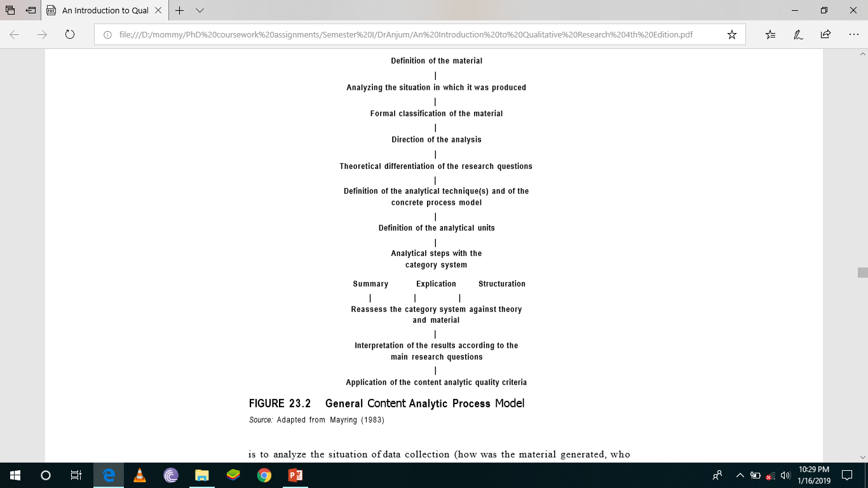

Slide 45
Conversation Analysis
Conversation Analysis (or CA) denotes a research approach dedicated to the investigation, along strictly empirical lines, of social interaction as a continuing process of producing and securing meaningful social order.
The Procedure of Conversation Analysis Ten Have (1999, p. 48) suggests the following steps for research projects usingconversation analysis as a method:
1 getting or making recordings of natural interaction; 2 transcribing the tapes, in whole or in part; 3 analyzing selected episodes; and 4 reporting the research.

Slide 46
Discourse Analysis
Discourse analysis has been developed from different backgrounds, one of which was conversation analysis. Discourse analytic procedures refer not only to everyday conversations, but also to other sorts of data such as interviews or media reports.
Parker (for example, 2004) has developed a model of critical discourse analysis, built on the background developed by Michel Foucault (e.g., Foucault 1980) which is why this is also referred to as "Foucauldian Discourse Analysis" (e.g., inWillig 2003). Here issues of critique, of ideology, and of power are more in focus than in other versions of discourse analysis. Parker suggests a number of steps in the research process:

Slide 47
Discourse Analysis
1 The researcher should turn the text to be analyzed into written form, if it is not already.
2 The next step includes free association to varieties of meaning as a way of accessing cultural networks, and these should be noted down.
3 The researchers should systematically itemize the objects, usually marked by nouns, in the text or selected portion of text.
4 They should maintain a distance from the text by treating the text itself as the object of the study rather than what it seems to "refer" to.
5 Then they should systematically itemize the "subjects"—characters, persona, role positions—specified in the text.
6 They should reconstruct presupposed rights and responsibilities of "subjects" specified in the text.
7 Finally, they should map the networks of relationships into patterns. These patterns in language axe "discourses," and can then be located in relations of ideology, power, and institutions, (see Parker 2004, p. 310)

Slide 48
Narrative and Hermeneutics
Narrative and hermeneutic approaches take into account the structure of the text. The analysis follows the structure of the text (sequentially) and sees the statements in this context. Biographical texts are analyzed in the light of the sequence of the events that is reported so that
(1) the internal structure of the life history and
(2) the external structure of the life reported in it may be related to each other. Social science hermeneutics links such a sequential analysis with open coding according to grounded theory research.

Slide 49
Issues in Qualitative research
• Traditional criteria often miss the specific features of qualitative research and data.
• There are many suggestions for alternative criteria, but none of them solves the problem of adequate quality assessment.
• One issue is whether to develop criteria for (1) qualitative research as a whole or (2) specific approaches in qualitative research.
• Criteria can focus on formal aspects (was the method applied correctly?) or on the quality of the insights produced by the research (what’s new?).
• Qualitative research is confronted by external entities (funding agencies, customers of qualitative research, and results) with the challenge of quality assessment.

Slide 50
Triangulation
Triangulation is also used as a strategy for improving the quality of qualitative research by extending the approach to the issue under study. This can be done in four ways.
The first way is to use additional methods (e.g., two qualitative methods or by adding a quantitative approach—using two methodological approaches in one method.
The second way is to include different sorts of data in your project.
The third way is to take a different theoretical perspective—studying the issue under study with more than one research perspective in qualitative research.
And finally the fourth way is to involve two or more researchers in the project with different theoretical-methodological backgrounds.
These four ways of triangulating methods, data, theories, and investigators were suggested by Denzin (1989b) and can be used as strategies for producing better knowledge in the research or as strategies for improving the quality of qualitative research

Slide 51
Triangulation
Theory triangulation is the third type in Denzin's systematology. The starting point is "approaching data with multiple perspectives and hypotheses in mind ....Various theoretical points of view could be placed side by side to assess their utility and power“.
Denzin mentions methodological triangulation. Here again, two subtypes should be differentiated: within-method and between-method triangulation.

Slide 52
You may use the following guiding questions for using triangulation:
• Does my issue under study require several methodological approaches?
• Does my research question focus on different aspects or levels of my issue?
• Do I have several theoretical perspectives on my issue?
• Are there different levels of information I need to collect for understanding my issue under study?
• Does the time frame for my study and my resources in general allow triangulation to be used?
• Can I expect my participants to be exposed to several methods (e.g., being observed and interviewed) or does this overly challenge them?

Slide 53
Important Schools of Research and Recent Developments
Grounded Theory (theory development)
Ethnomethodology, Conversation, Discourse, and Genre Analysis
Ethnography
Cultural Studies
Narrative Analysis and Biographical Research
Gender Studies

